Slide 1
Working with AI tools
How do I brief an AI tool and check what it returns?
Applied AI and Automation | Session 3 of 12
KLAi Professional Learning | Jotham Martin Wambi
Notes:
Welcome back. Last session you saw four cases where an assistant was tested, and you wrote the checks for your own task. Today I show you the same email written from a weak prompt and from a strong brief, with every figure recounted, and then you write the brief for your own task on paper.
The question for today is this: How do I brief an AI tool and check what it returns? Keep it in mind. At the end of the session we come back to it and see how much more you can say.

Slide 2



Today in one view: what you will leave with
By the end of today you will have
A clear view of the kinds of AI assistant and the five account questions to ask before company data goes in
A weak prompt and a strong brief for the same email, side by side, with every figure recounted
A seven-part brief for your own task, written on paper, and a plan for checking its result
Notes:
Here is what you leave with today. A clear view of the kinds of assistant, and the five questions to ask about an account before company data goes in. A weak prompt and a strong brief for the same email, side by side, with the figures checked. And a seven-part brief for your own task, with a plan for checking what comes back. We build nothing in a tool today.

Slide 3
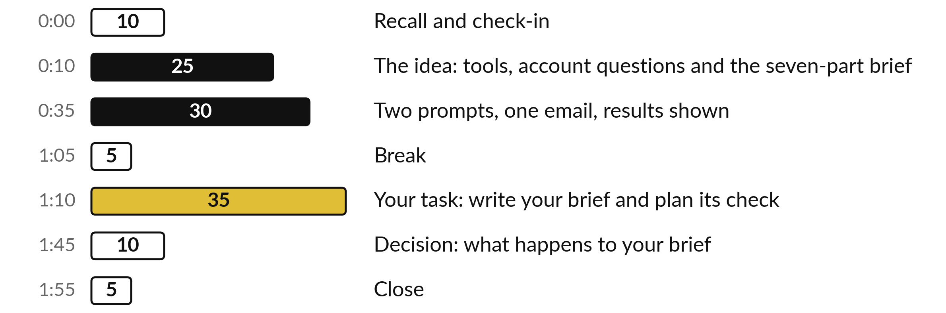
Your two hours: a weak prompt,
a strong brief, then yours
35 of the 120 minutes are yours: write your brief and plan its check.
Notes:
Three parts matter most today. I spend twenty-five minutes on tools, account questions and the seven parts of a brief. Then thirty minutes on the two prompts and their results. After the break, thirty-five minutes are yours: you write your brief on paper and plan how you will check its result.
If we run long, I shorten my talking and keep your time.

Slide 4

Three questions from last time
1. How does an assistant produce an answer, and why can it be fluent and wrong?
2. Name the four failures from Session 2 and the control for each.
3. In the handbook case, which two questions could the document not answer, and what did Claude do?
Answer aloud first. Then we check together.
Notes:
Three quick questions from Session 2. Answer aloud first, and then we check together. It is a warm-up to bring last time back.
Question one. How does an assistant produce an answer, and why can it be fluent and wrong? Take a moment.
A good answer is this. It writes a likely next word from patterns learned in training and is tuned to help. Unless search, files or memory are on, nothing in that process checks a fact.
Question two. Name the four failures from Session 2 and the control for each. Say it to yourself first.
A good answer is this. Made-up facts: open every source. Beyond the document: give the document and allow not stated. Sources disagree: ask for both figures. Wrong sums: recount in a sheet.
Question three. In the handbook case, which two questions could the document not answer, and what did Claude do? Think about your own task as you answer.
A good answer is this. Paid sick days and the rate a kilometre for a private car. In both runs Claude wrote not stated. It had been told it could.
If an answer was missing, your own task card or last workbook page has it. Now to today.

Slide 5




Words we use today
Word | What it means
Prompt | Anything you type into an assistant.
Brief | A prompt written once, in seven parts, and reused.
Assistant | The product you talk to. The model is the engine inside it.
Source | The original document or sheet a figure or claim comes from.
Notes:
Four words for today. I give the plain meaning of each, and we use every one of them before the end of the session.
Prompt. Anything you type into an assistant.
Brief. A prompt written once, in seven parts, and reused.
Assistant. The product you talk to. The model is the engine inside it.
Source. The original document or sheet a figure or claim comes from.

Slide 6
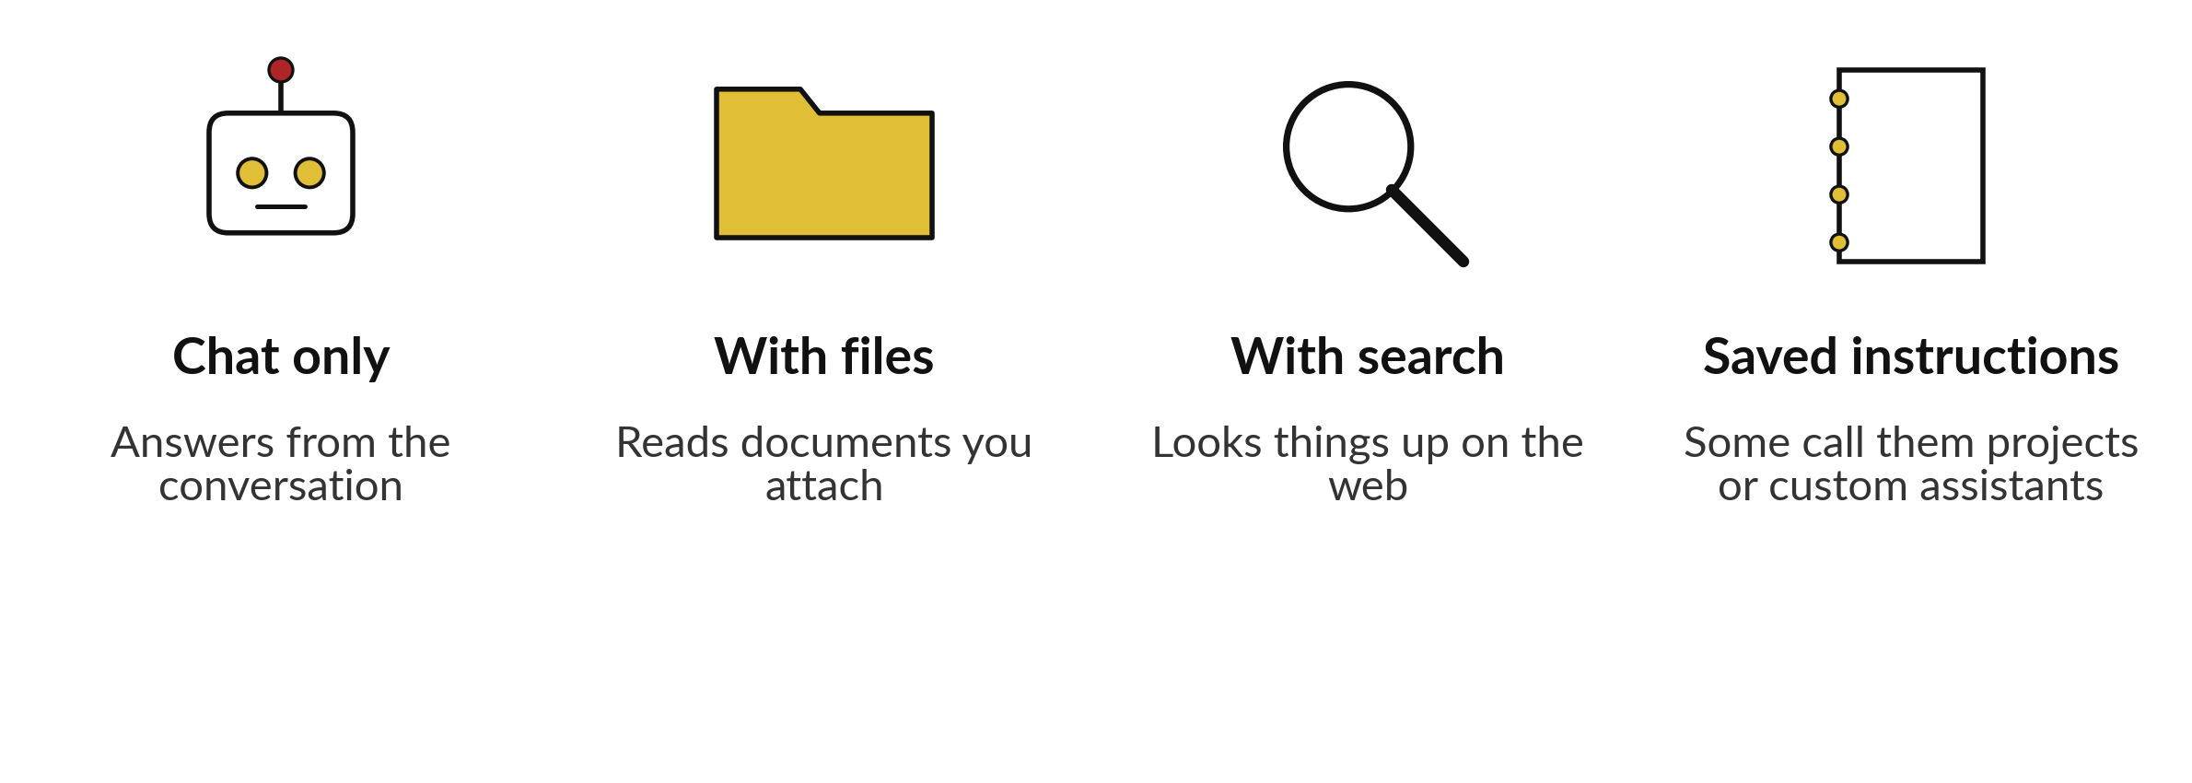
Assistants differ in what they can reach
Until your policy in Session 9, put nothing from your company into a tool.
Notes:
First, the words I use all day. A prompt is anything you type. A brief is a prompt written once, in seven parts, and reused. The assistant is the product you talk to, and the model is the engine inside it. Assistants come in four common kinds. Chat only, which answers from the conversation.
With files, which reads documents you attach. With search, which can look things up on the web. And with saved instructions, which some tools call projects or custom assistants. Check which your account offers. Until your policy in Session 9, put nothing from your company into a tool.

Slide 7



Ask the same five questions about any product
Does the tool train on what I paste?
How long does it keep my chats?
Who in my company can see my chats?
Is this a work account or a personal one?
Does my company rule allow this tool?
Notes:
Whatever product you use, the five questions are the same. The answers depend on the plan more than on the brand. A free personal account, a business plan and an enterprise plan can answer differently, and the answers change over time, so read your own settings and terms.
Does it train on what you paste?
How long does it keep chats?
Who in your company can see them?
Is it a work account or a personal one?
Does your company rule allow it?
At Nile Valley Foods, handbook clause 4.4 says customer data, price lists and contracts may not go into a public AI tool without the Managing Director approving it in writing.

Slide 8







A brief has six parts for the tool and one for you
Part | What you write | Nile Valley Foods example
1 Goal | What should exist, and who reads it | Monday sales email for the directors
2 Context | Who we are and what readers need | Food distributor in Jinja
3 Inputs | Exactly what I give you | Two weeks of sales figures
4 Constraints | Length, tone, what to leave out | 150 words, invent nothing
5 Format | The shape of the answer, with one short example | Subject, summary, table, one thing to check
6 My check | What I will compare | Each figure against the data
7 If unsure | What to write instead of a guess | Say what the data cannot show
This is the layout of the Reusable Brief Template. Part 6 is your own step. It is not an instruction to the tool.
Notes:
This is the structure of your brief, taken from your template. Goal, context, inputs, constraints, format, how I will check, and what to write when unsure. Part seven is the line that tells the tool what to do when it cannot support a claim. In our strong email it said the data does not show why volumes rose.
Part six is different. It is a note to yourself about what you will compare before you send, so it is not an instruction to the tool. You write the brief once, check it, and reuse it. Next time you change only the inputs. Now I show you what these parts did for one email.

Slide 9
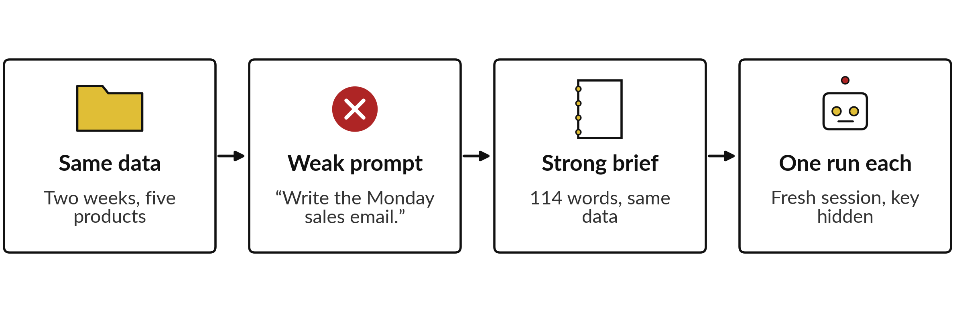
Two prompts for the same
email were run the same way
Claude, fresh session, prompt only, 4 Nov 2026, key hidden. One run each.
Notes:
Here is how the two results were made. Both prompts carried the same data: total revenue, units and revenue for five products, for the weeks starting the twelfth and the nineteenth of October. The weak prompt was one line, write the Monday sales email, plus the data. The strong brief was one hundred and fourteen words.
I gave each to Claude as a fresh session that was given only the prompt and told to use no other tool or file, except to save its answer, with no answer key. I cannot prove from outside that it used nothing else. I ran each only once.
This is Claude, not ChatGPT or Gemini. One run each is a small sample, so I do not call the result typical, and another product or another day may differ.

Slide 10







The strong brief fills six of
seven parts, and part 6 is yours
Part | Weak prompt | Strong brief
1 Goal and reader | Write the Monday sales email | Email to Sarah Namukasa
2 Context | None | Sales analyst at Nile Valley Foods
3 Inputs | The data, no limit | Use only the figures below
4 Constraints | None | Invent no number, cause or customer. Under 150 words
5 Format | None | Subject, summary, table, three sentences, one check
6 My check | Not in the prompt | Not in the prompt
7 If unsure | None | If the data cannot explain it, say so
Taken from the two requests. The strong brief gave no example answer; part 5 lets you add one.
Notes:
This is what each prompt actually told the assistant. The weak prompt gave a goal and the data, and nothing else. It did not say who reads the email, how long it should be, what shape it takes, or what to do when the data cannot explain something.
The strong brief named the reader, the role, the limit on inputs, the length and tone, the exact format, and what to do when unsure. Part six is not in either prompt, because it is your step afterwards. That is why the title says the strong brief fills six of seven. After this I show what each prompt produced.

Slide 11
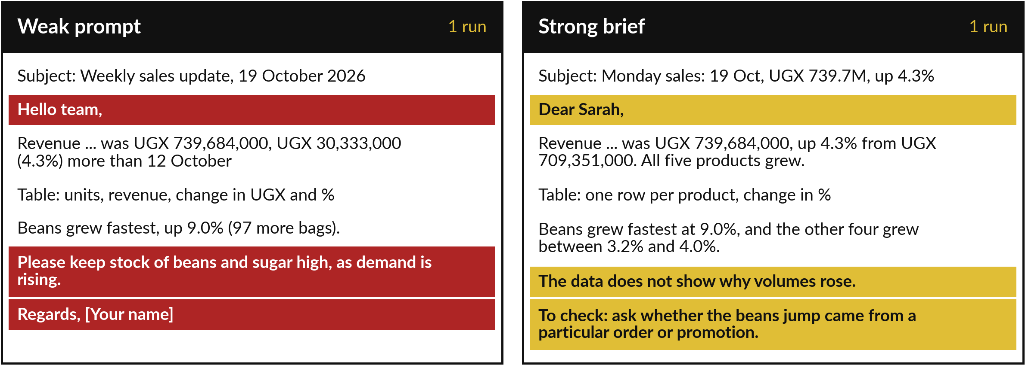
Side by side: same figures,
different fit for the reader
Gold: asked for by the strong brief. Red: settled or forbidden by it. Claude, 4 Nov 2026, key hidden.
Notes:
Here are extracts from the two emails, side by side. On the left, the weak prompt. The weak prompt gave no reader, so it wrote to the team, although the real reader is a director. It ends with advice to keep stock of beans and sugar high because demand is rising, which two weeks of data hardly support and nobody asked for.
And it signs off with a placeholder, your name. Red shows what the strong brief settles or forbids. It does not say the weak prompt broke an instruction. On the right, the strong brief. It writes to Sarah, it says the data does not show why volumes rose, and it ends with one thing to check, as the brief asked.
These are extracts from one run each, and I show you the figures after this.

Slide 12




Every figure in both emails matches my recount
Figure | My recount | Weak email | Strong email
Total, week of 19 Oct | UGX 739,684,000 | Correct | Correct
Change on the week | +30,333,000, 4.28% | Both, as 4.3% | 4.3%
Maize flour revenue | +4.03% | +4.0% | +4.0%
Cooking oil revenue | +3.42% | +3.4% | +3.4%
Rice revenue | +3.16% | +3.2% | +3.2%
Sugar revenue | +3.78% | +3.8% | +3.8%
Beans revenue | +8.99% | +9.0% | +9.0%
Other claims | Prices unchanged | Also 97 bags, 28% | Also correct
Recomputed from the data in the request. Claude, fresh session, 4 Nov 2026, key hidden, 1 run each.
Notes:
I recomputed every figure in both emails from the data. The total is right in both. The change on the week is thirty million, three hundred and thirty-three thousand shillings, which is four point two eight percent, and both round it to four point three. The five product changes match to one decimal place, and units and revenue changed by the same percentage because prices did not change.
The weak email also says ninety-seven more bags of beans and sugar at twenty-eight percent of revenue, and both are right. So the difference between the two emails is not accuracy. It is fit, extra claims, and whether the email is finished.

Slide 13


What the brief changed, and what it did not
The brief changed
It did not change
Reader named: asked for
No extra advice: asked for
Says what data lacks: asked for
101 words against 157; no limit was set on the weak one
The figures were right in both
You still check the result
One run each is small
A brief fits the answer. It does not replace the check.
Notes:
So what did the brief buy?
These are one run each, and the strong brief asked for each of these things, so the email following them proves little by itself. Left side: a named reader, no placeholder, no advice the data cannot support, an honest line about what the data cannot show, and a shorter email, one hundred and one words against one hundred and fifty-seven, counting everything but the table.
The weak prompt set no length limit and its count includes a closing note. Right side: it did not change the figures, which were right in both. The strong brief did not remove the need to check, and one run each proves little. Notice also that the weak email was not wrong about the numbers.
Its problem was that it was not ready to send, and it said more than the data supports.

Slide 14
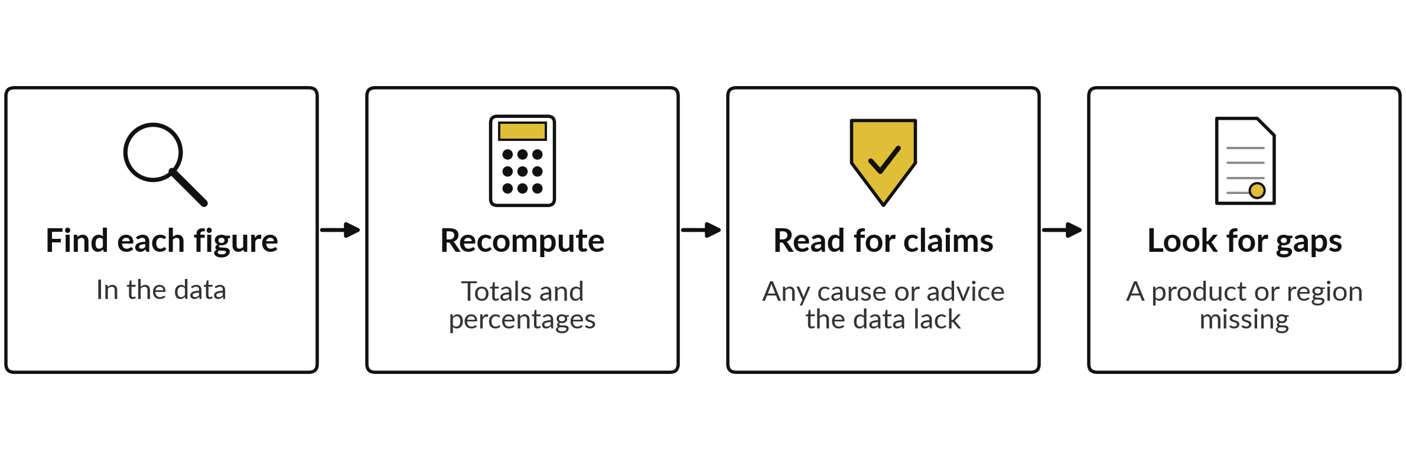
Check the email in four moves
At Nile Valley Foods the review is planned at 20 minutes. Every mistake you find becomes a rule in the brief.
Notes:
This is part six of the brief, and it is yours. Find each figure in the data. Recompute totals and percentages, because a sum that looks right is not proof, as you saw in Session 2. Read for claims the data lack, such as a cause for a change or advice that nobody asked for.
In the weak email, that was the advice about stock. And look for what is missing, such as a product or a region left out. At Nile Valley Foods the plan counts twenty minutes for this review. Every mistake you find becomes a rule you add to the brief, so the brief improves each time.

Slide 15
A complete brief, with your own check beside it
1 Goal
Write the Monday sales email to Sarah Namukasa.
2 Context
I am the sales analyst at Nile Valley Foods, Jinja.
3 Inputs
Use only the figures I paste after this brief.
4 Constraints
Invent nothing. Under 150 words plus table.
5 Format
Subject, table, three sentences, one check, one example.
6 My check
Not pasted. I find each figure and recount the totals.
7 If unsure
If the data cannot explain something, say so.
Notes:
Here is a complete brief for the Monday sales email, in the shape of your template. It follows the strong brief we just saw, with part six beside it for you. Read it from the top. The goal names the reader. The inputs are limited to the figures I paste.
The constraints forbid invented numbers, causes and customers. The format fixes the email shape. Part six is a line for me and I do not paste it. Part seven says what to do when the data cannot explain something. Yours will be about this long. Now you decide which part will be hardest.

Slide 16




Decision: which part of the brief
will be hardest for your task?
Choose one part, and say why.
Goal and reader
Inputs
Format and length
If unsure, and my check
Who reads it, and what they need
What the tool may use, and what it must not
The shape of a finished answer
What to write, and what I compare
Say your choice and your reason aloud. Then we take the break.
Notes:
Before the break, each of you decides. Which part of the brief will be hardest to write for your task?
Goal and reader, inputs, format and length, or what to do when unsure and how you check. Say your choice and a reason. People who lead teams often find the reader the hardest, because the email goes to several people. People in finance often find the inputs hardest, because the figures live in several places.
Session 4 deals with that. Whichever you choose, start with that part after the break, while it is fresh.

Slide 17
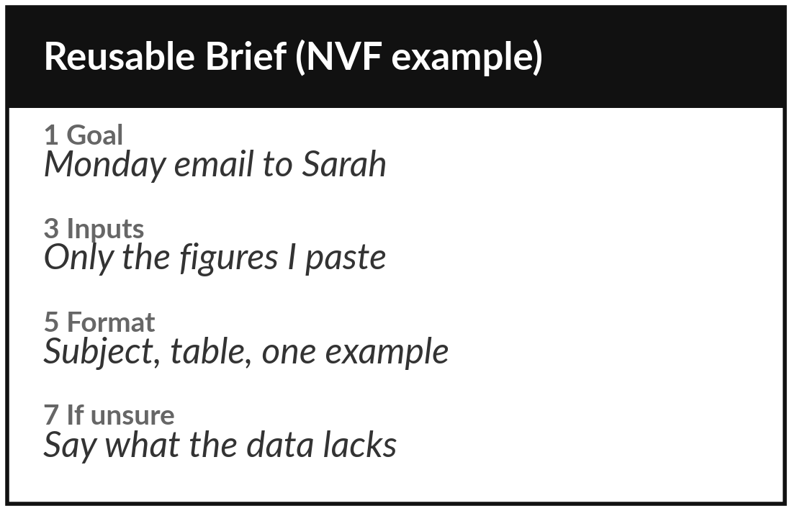
Practice: write your seven-part brief on paper
20 minutes
Your own company task
Write a reusable brief for your own task in the template.
Open the Reusable Brief Template.
Write all seven parts, a line or two each, starting with your hardest.
Part 5: describe the shape, with one short invented example.
Part 7: say what to write when unsure, from your Session 2 page.
You keep: A seven-part brief on paper, ready to paste later.
Notes:
Take twenty minutes. Write short, a line or two for each part. Open the Reusable Brief Template and write all seven parts for your own task, on paper. Start with the part you chose as hardest. Name the reader. Say exactly what the tool may use. In part five, describe the shape of a good answer and add one short invented example, with no real names or amounts.
For part seven, use what you wrote on your reliability page in Session 2: what to say when the data cannot support a claim. We open no tool in class. I walk round and read briefs with you.

Slide 18
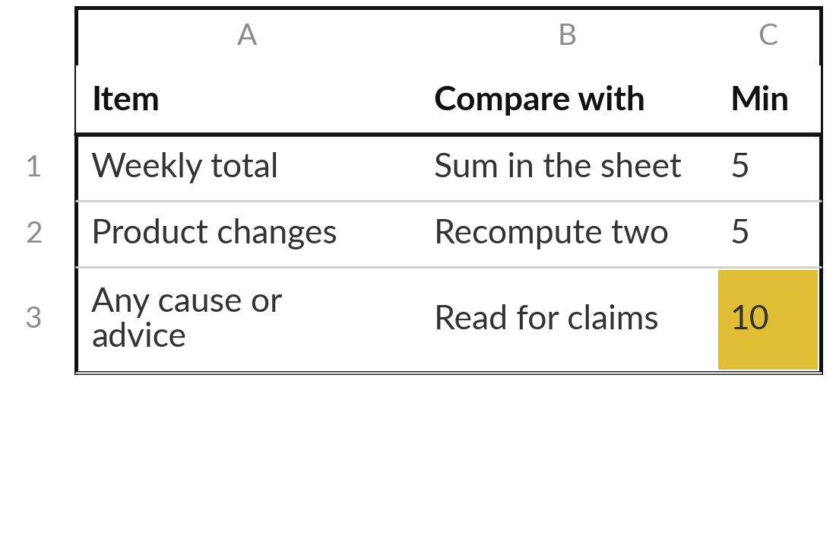
Practice: plan the check for your brief
15 minutes
Your own company task
Write how you will check what the brief returns.
List the figures, names and dates the answer will carry.
Write what you compare each one with.
Estimate the minutes, and say who does it.
Compare with the review time on your task card.
You keep: A check plan: items, source, minutes and owner.
Notes:
Another fifteen minutes. Write your check plan, which is part six made concrete. List the figures, names and dates the answer will carry. Next to each, write what you compare it with. Estimate the minutes and say who does it. Then compare the total with the review time on your task card from Session 1.
If the check takes as long as doing the work by hand, write that down, because it tells you the task or the brief needs another look. You say your plan aloud in two minutes at the end.

Slide 19


Decision: what happens to your brief next?
Which fits your brief today?
Save it as written
Ask a colleague to read it
Revise after Session 4
It is clear enough. Keep it in the template.
A second reader shows what is unclear. Then improve it.
The inputs need work first. Come back with them.
Write your choice and the reason on the template.
Notes:
Time to decide. What happens to your brief next?
Save it as written, because it is clear enough and you keep it in the template. Ask a colleague to read it, because a second reader shows what is unclear, and then improve it. Or revise it after Session 4, because the inputs need work first. That last choice is a good one if the information for your task is scattered, and Session 4 is about exactly that.
Say your choice aloud with your reason, and write both on the template.

Slide 20
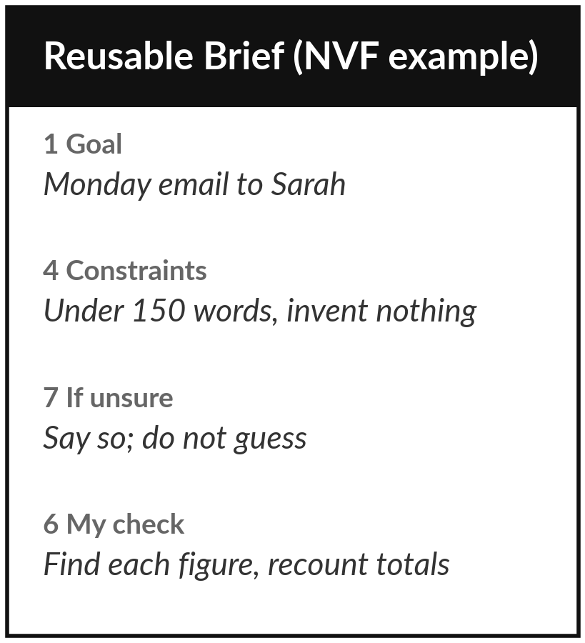
Save it, and keep it for Session 4
What you keep from today
Your seven-part brief for your own task, in the Reusable Brief Template, and your plan for checking the result.
Our question today
How do I brief an AI tool and check what it returns?
Next session
Session 4: Your information: is your data ready for AI? Optional: think about where the information for your task is kept.
Notes:
Save the brief where you can paste it later, and keep the check plan next to it. In Session 4 we look at the information that feeds part three of the brief. Until your policy in Session 9, put nothing from your company into a tool.
We began with this question: How do I brief an AI tool and check what it returns? Before you go, say in one sentence what you can now say about it.

